Slide 1
WHAT MAKES AN ANDROID APPLICATION?

Slide 2
Android applications consist of loosely coupled components, bound by the application manifest that describes each component and how they interact.
Activities- Your application’s presentation layer.
Services -The invisible workers of your application
Content Providers - Shareable persistent data
storage.
Intents - A powerful inter application
message-passing framework.
Broadcast Receivers- Intent listeners.
Widgets- Visual application components that
are typically added to the device home screen.
Notiﬁcations- Notiﬁcations enable you to alert
users to application events without stealing focus
or interrupting their current Activity.

Slide 3
Android Developer Fundamentals
Activities

Slide 4
Activities
(high-level view)

Slide 5
What is an Activity?
An Activity is an application component
Represents one window, one hierarchy of views
Typically fills the screen, but can be embedded in other activity or a appear as floating window
Java class, typically one activity in one file

Slide 6
What does an Activity do?
Represents an activity, such as ordering groceries, sending email, or getting directions
Handles user interactions, such as button clicks, text entry, or login verification
Can start other activities in the same or other apps
Has a life cycle—is created, started, runs, is paused, resumed, stopped, and destroyed

Slide 7
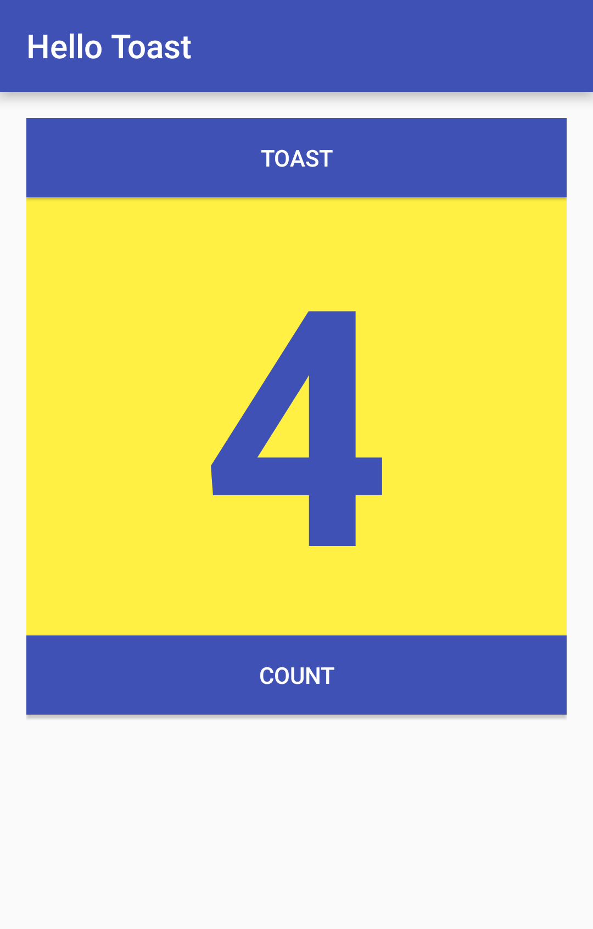
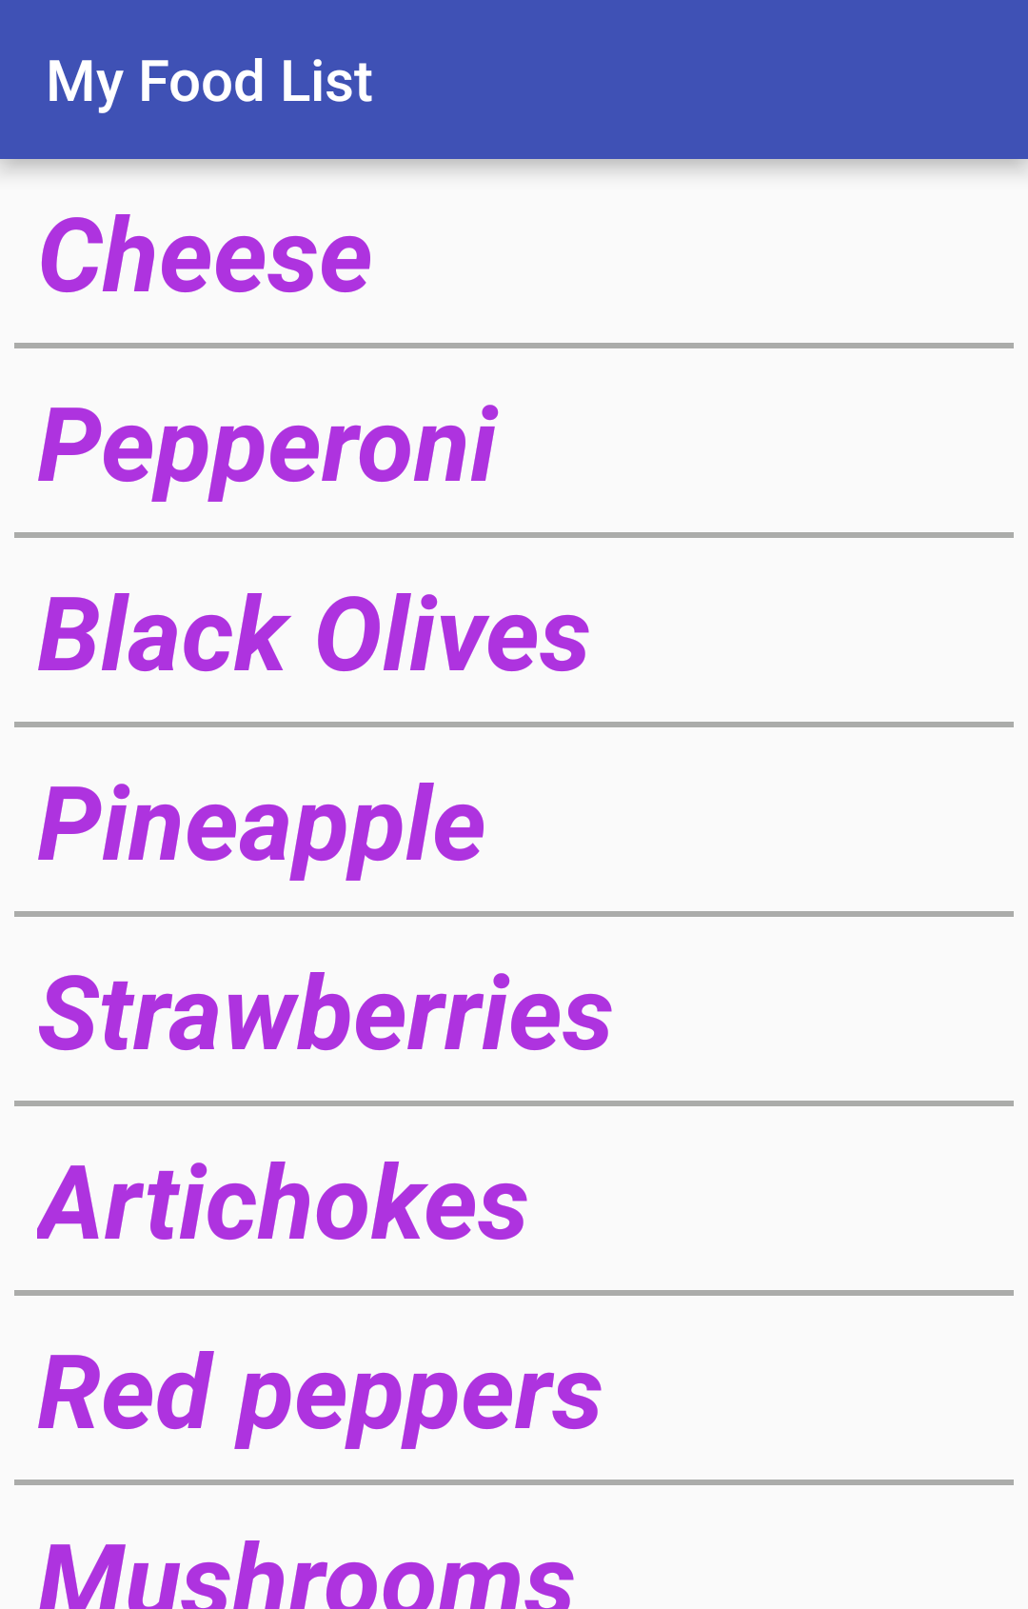
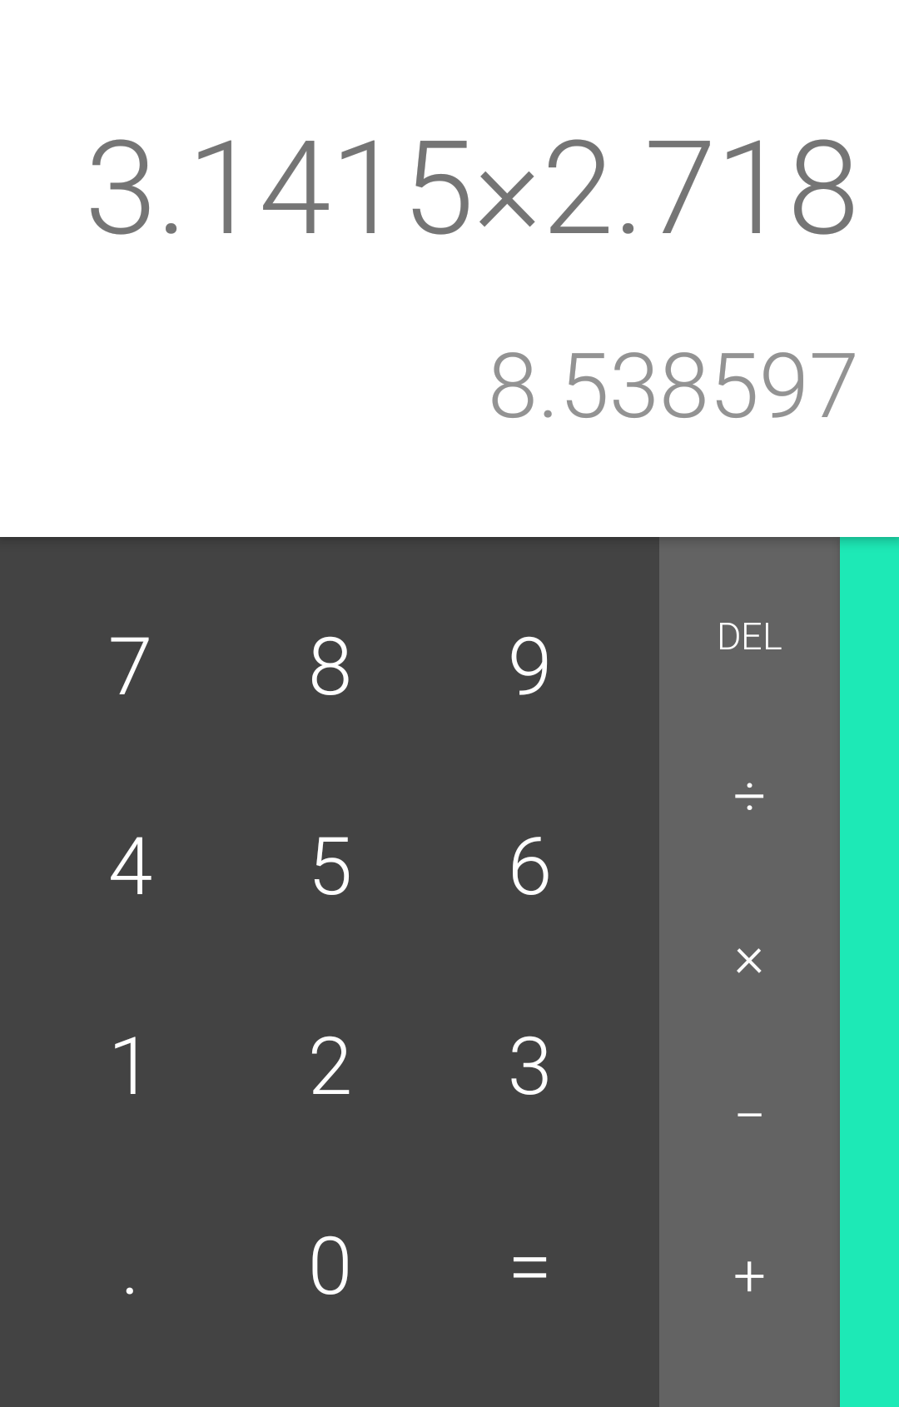
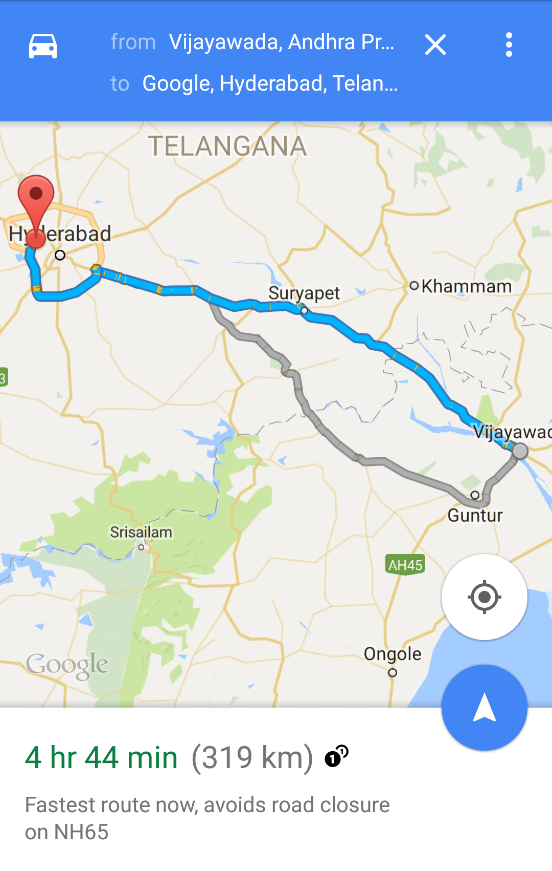
Examples of activities

Slide 8
Apps and activities
Activities are loosely tied together to make up an app
First activity user sees is typically called "main activity"
Activities can be organized in parent-child relationships in the Android manifest to aid navigation

Slide 9
Layouts and Activities
An activity typically has a UI layout
Layout is usually defined in one or more XML files
Activity "inflates" layout as part of being created

Slide 10
Implementing Activities

Slide 11
Implement new activities
Define layout in XML
Define Activity Java class
  extends AppCompatActivity
Connect Activity with Layout
  Set content view in onCreate()
Declare Activity in the Android manifest

Slide 12
Define layout in XML
<?xml version="1.0" encoding="utf-8"?>
<RelativeLayout
xmlns:android="http://schemas.android.com/apk/res/android"
android:layout_width="match_parent"
android:layout_height="match_parent">
<TextView
android:layout_width="wrap_content"
android:layout_height="wrap_content"
android:text="Let's Shop for Food!" />
</RelativeLayout>

Slide 13
2. Define Activity Java class
public class MainActivity extends AppCompatActivity {
@Override
protected void onCreate(Bundle savedInstanceState) {
super.onCreate(savedInstanceState);
}
}

Slide 14
3. Connect activity with layout
public class MainActivity extends AppCompatActivity {
@Override
protected void onCreate(Bundle savedInstanceState) {
super.onCreate(savedInstanceState);
setContentView(R.layout.activity_main);
}
}
Resource
is layout
in this XML file

Slide 15
4. Declare activity in Android manifest
<activity android:name=".MainActivity">

Slide 16
4. Declare main activity in manifest
Main Activity needs to include intent to start from launcher icon
<activity android:name=".MainActivity">
<intent-filter>
<action android:name="android.intent.action.MAIN" />
<category android:name="android.intent.category.LAUNCHER" />
</intent-filter>
</activity>

Slide 17
Intents

Slide 18
What is an intent?
An intent is a description of an operation to be performed.
An Intent is an object used to request an action from another app component via the Android system.
Originator
App component
Intent
Action
Android System

Slide 19
What can intents do?
Start activities
  A button click starts a new activity for text entry
  Clicking Share opens an app that allows you to post a photo
Start services
  Initiate downloading a file in the background
Deliver broadcasts
  The system informs everybody that the phone is now charging

Slide 20
Explicit and implicit intents
Explicit Intent
Starts a specific activity(We know the source and destination)
  Main activity starts the ViewShoppingCart activity
Implicit Intent (Intent Resolution)
Asks system to find an activity that can handle this request
  Find an open store that sells green tea
  Clicking Share opens a chooser with a list of apps

Slide 21
Starting Activities

Slide 22
Start an Activity with an explicit intent
To start a specific activity, use an explicit intent
Create an intent
  Intent intent = new Intent(this, ActivityName.class);
Use the intent to start the activity
  startActivity(intent);

Slide 23
Start an Activity with implicit intent
To ask Android to find an Activity to handle your request, use an implicit intent
Create an intent
  Intent intent = new Intent(action, uri);
Use the intent to start the activity
  startActivity(intent);

Slide 24
Implicit Intents - Examples
Show a web page
Uri uri = Uri.parse("http://www.google.com");
Intent it = new Intent(Intent.ACTION_VIEW,uri);
startActivity(it);
Dial a phone number
Uri uri = Uri.parse("tel:8005551234");
Intent it = new Intent(Intent.ACTION_DIAL, uri);
startActivity(it);

Slide 25
How Activities Run
All activities are managed by the Android runtime
Started by an "intent", a message to the Android runtime to run an activity
User clicks launcher icon
MainActivity
What do you want to do?
FoodListActivity
Choose food items...Next
OrderActivity
Place order
Intent: Start app
Start main activity
Intent: Shop
Start choose food activity
Intent: order
Start finish
order activity
Android System
Android System
Android System

Slide 26
Activity Lifecycle

Slide 27
What is the Activity Lifecycle?
The set of states an activity can be in during its lifetime, from when it is created until it is destroyed
More formally:
A directed graph of all the states an activity can be in, and the callbacks associated with transitioning from each state to the next one

Slide 28
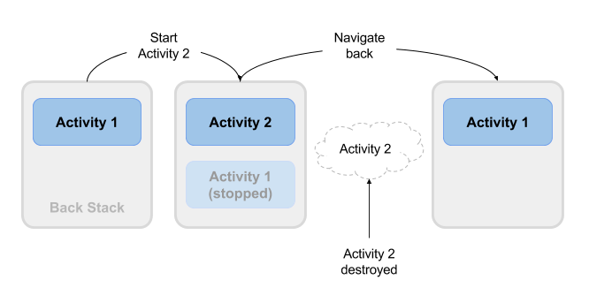
What is the Activity Lifecycle?

Slide 29
Activity states and app visibility
Created (not visible yet)
Started (visible)
Resume (visible)
Paused(partially invisible)
Stopped (hidden)
Destroyed (gone from memory)
State changes are triggered by user action, configuration changes such as device rotation, or system action

Slide 30
Callbacks and when they are called
onCreate(Bundle savedInstanceState)—static initialization
onStart()—when activity (screen) is becoming visible
onRestart()—called if activity was stopped (calls onStart())
onResume()—start to interact with user
onPause()—about to resume PREVIOUS activity
onStop()—no longer visible, but still exists and all state info preserved
onDestroy()—final call before Android system destroys activity

Slide 31
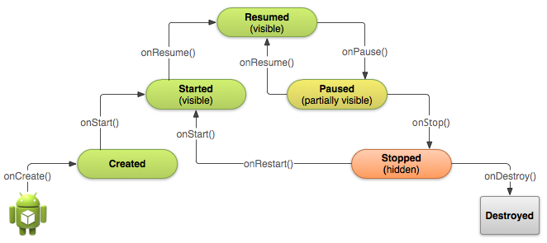
Activity states and callbacks graph

Slide 32
Implementing and overriding callbacks
Only onCreate() is required
Override the other callbacks to change default behavior

Slide 33
onCreate() –> Created
Called when the activity is first created, for example when user taps launcher icon
Does all static setup: create views, bind data to lists, ...
Only called once during an activity's lifetime
Takes a Bundle with activity's previously frozen state, if there was one
Created state is always followed by onStart()

Slide 34
onCreate(Bundle savedInstanceState)
@Override
public void onCreate(Bundle savedInstanceState) {
super.onCreate(savedInstanceState);
// The activity is being created.
}

Slide 35
onStart() –> Started
Called when the activity is becoming visible to user
Can be called more than once during lifecycle
Followed by onResume() if the activity comes to the foreground, or onStop() if it becomes hidden

Slide 36
onStart()
@Override
protected void onStart() {
super.onStart();
// The activity is about to become visible.
}

Slide 37
onRestart() –> Started
Called after activity has been stopped, immediately before it is started again
Transient state
Always followed by onStart()

Slide 38
onRestart()
@Override
protected void onRestart() {
super.onRestart();
// The activity is between stopped and started.
}

Slide 39
onResume() –> Resumed/Running
Called when activity will start interacting with user
Activity has moved to top of the activity stack
Starts accepting user input
Running state
Always followed by onPause()

Slide 40
onResume()
@Override
protected void onResume() {
super.onResume();
// The activity has become visible
// it is now "resumed"
}

Slide 41
onPause() –> Paused
Called when system is about to resume a previous activity
The activity is partly visible but user is leaving the activity
Typically used to commit unsaved changes to persistent data, stop animations and anything that consumes resources
Implementations must be fast because the next activity is not resumed until this method returns
Followed by either onResume() if the activity returns back to the front, or onStop() if it becomes invisible to the user

Slide 42
onPause()
@Override
protected void onPause() {
super.onPause();
// Another activity is taking focus
// this activity is about to be "paused"
}

Slide 43
onStop() –> Stopped
Called when the activity is no longer visible to the user
New activity is being started, an existing one is brought in front of this one, or this one is being destroyed
Operations that were too heavy-weight for onPause
Followed by either onRestart() if this activity is coming back to interact with the user, or onDestroy() if this activity is going away

Slide 44
onStop()
@Override
protected void onStop() {
super.onStop();
// The activity is no longer visible
// it is now "stopped"
}

Slide 45
onDestroy() –> Destroyed
Final call before activity is destroyed
User navigates back to previous activity, or configuration changes
Activity is finishing or system is destroying it to save space
Call isFinishing() method to check
System may destroy activity without calling this, so use onPause() or onStop() to save data or state

Slide 46
onDestroy()
@Override
protected void onDestroy() {
super.onDestroy();
// The activity is about to be destroyed.
}

Slide 47
Activity Instance State

Slide 48
When does config change?
Configuration changes invalidate the current layout or other resources in your activity when the user:
rotates the device
chooses different system language, so locale changes
enters multi-window mode (Android 7)

Slide 49
What happens on config change?
On configuration change, Android:
1. shuts down activity
by calling:
2. then starts it over
by calling:
onPause()
onStop()
onDestroy()
onCreate()
onStart()
onResume()

Slide 50
Activity instance state
State information is created while the activity is running, such as a counter, user text, animation progression
State is lost when device is rotated, language changes, back-button is pressed, or the system clears memory

Slide 51
Activity instance state
System only saves:
  State of views with unique ID (android:id) such as text entered into EditText
  Intent that started activity and data in its extras
You are responsible for saving other activity and user progress data

Slide 52
Saving instance state
Implement onSaveInstanceState() in your activity
called by Android runtime when there is a possibility the activity may be destroyed
saves data only for this instance of the activity during current session

Slide 53
onSaveInstanceState(Bundle outState)
@Override
public void onSaveInstanceState(Bundle outState) {
super.onSaveInstanceState(outState);
// Add information for saving HelloToast counter
// to the to the outState bundle
outState.putString("count",
String.valueOf(mShowCount.getText()));
}

Slide 54
Restoring instance state
Two ways to retrieve the saved Bundle
in onCreate(Bundle mySavedState)
Preferred, to ensure that your user interface, including any saved state, is back up and running as quickly as possible
Implement callback (called after onStart())
onRestoreInstanceState(Bundle mySavedState)

Slide 55
Restoring in onCreate()
@Override
protected void onCreate(Bundle savedInstanceState) {
super.onCreate(savedInstanceState);
setContentView(R.layout.activity_main);
mShowCount = (TextView) findViewById(R.id.show_count);
if (savedInstanceState != null) {
String count = savedInstanceState.getString("count");
if (mShowCount != null)
mShowCount.setText(count);
}
}

Slide 56
onRestoreInstanceState(Bundle state)
@Override
public void onRestoreInstanceState (Bundle mySavedState) {
super.onRestoreInstanceState(mySavedState);
if (mySavedState != null) {
String count = mySavedState.getString("count");
if (count != null)
mShowCount.setText(count);
}
}

Slide 57
Instance state and app restart
When you stop and restart a new app session, the activity instance states are lost and your activities will revert to their default appearance
If you need to save user data between app sessions, use shared preferences or a database.

Slide 58
Styles and Themes
A style is a collection of attributes that specify the look and format for a View or window.
A style can specify attributes such as height, padding, font color, font size, background color, and much more.
A style is defined in an XML resource that is separate from the XML that specifies the layout.
For example, by using a style, you can take this layout XML:
<TextView
android:layout_width="match_parent"
android:layout_height="wrap_content"
android:textColor="#00FF00"
android:typeface="monospace"
android:text="@string/hello" />
And turn it into this:
<TextView
android:layout_width="match_parent"
android:layout_height="wrap_content"
android:textAppearance="@style/CodeFont"
android:text="@string/hello" />
The attributes related to style have been removed from the layout XML and put into a
style definition called CodeFont, which is then applied using the android:textAppearance attribute.

Slide 59
Defining Styles
To create a set of styles, save an XML file in the res/values/ directory of your project.
The name of the XML file must use the .xml extension,
and like other resources, it must use lowercase, underscores, and be saved in the res/values/ folder.
The root node of the XML file must be <resources>.
For each style you want to create, complete the following series of steps:
Add a <style> element to the file, with a name that uniquely identifies the style.
For each attribute of that style, add an <item> element, with a name that declares the style attribute. The order of these elements doesn't matter.
Add an appropriate value to each <item> element.
Depending on the attribute, you can use values with the following resource types in an <item> element:
Fraction
Float
Boolean
Color
String
Dimension
Integer

Slide 60
Apply a theme to an activity or app
To set a theme for all the activities of your app, open the AndroidManifest.xml file and edit the <application> tag to include the android:theme attribute with the style name.
For example:
<application android:theme="@style/CustomTheme">
If you want a theme applied to just one activity in your app, then add the android:theme attribute to the <activity> tag instead.
Just as Android provides other built-in resources, there are many pre- defined themes that you can use, to avoid writing them yourself.
For example, you can use the Dialog theme and make your activity appear like a dialog box:
<activity android:theme="@android:style/Theme.Dialog">
Or if you want the background to be transparent, use the Translucent theme:
<activity android:theme="@android:style/Theme.Translucent">

Slide 61
If you like a theme, but want to tweak it, just add the theme as the parent of your custom theme. For example, you can modify the traditional light theme to use your own color like this:
<color name="custom_theme_color">#b0b0ff</color>
<style name="CustomTheme" parent="android:Theme.Material.Light">
<item name="android:windowBackground">@color/custom_theme_color</item>
<item name="android:colorBackground">@color/custom_theme_color</item>
</style>
Now use CustomTheme instead of Theme.Light inside the Android manifest:
<activity android:theme="@style/CustomTheme">
To discover the themes available in the Android Framework, search the R.style reference for constants that begin with Theme_.

Slide 62
You can further adjust the look and format of your app by using a theme overlay. Theme overlays allow you to override some of the style attributes applied to a subset of the components styled by a theme. For example, you might want to apply a darker theme to a toolbar in an activity that uses a lighter theme. If you are using Theme.Material.Light as the theme for an activity, you can apply ThemeOverlay.Material.Dark to the toolbar using the android:theme attribute to modify the appearance as follows:
Change the toolbar colors to a dark theme but preserve other style attributes, such as those relating to size.
The theme overlay applies to any children inflated under the toolbar.

Slide 63
Intents

Slide 64
What is an intent?
An intent is a description of an operation to be performed.
An Intent is an object used to request an action from another app component via the Android system.
Originator
App component
Intent
Action
Android System

Slide 65
What can intents do?
Start activities
  A button click starts a new activity for text entry
  Clicking Share opens an app that allows you to post a photo
Start services
  Initiate downloading a file in the background
Deliver broadcasts
  The system informs everybody that the phone is now charging

Slide 66
Explicit and implicit intents
Explicit Intent
Starts a specific activity
  Request tea with milk delivered by Nikita
  Main activity starts the ViewShoppingCart activity
Implicit Intent
Asks system to find an activity that can handle this request
  Find an open store that sells green tea
  Clicking Share opens a chooser with a list of apps

Slide 67
Starting Activities

Slide 68
Start an Activity with an explicit intent
To start a specific activity, use an explicit intent
Create an intent
  Intent intent = new Intent(this, ActivityName.class);
Use the intent to start the activity
  startActivity(intent);

Slide 69
Start an Activity with implicit intent
To ask Android to find an Activity to handle your request, use an implicit intent
Create an intent
  Intent intent = new Intent(action, uri);
Use the intent to start the activity
  startActivity(intent);

Slide 70
Implicit Intents - Examples
Show a web page
Uri uri = Uri.parse("http://www.google.com");
Intent it = new Intent(Intent.ACTION_VIEW,uri);
startActivity(it);
Dial a phone number
Uri uri = Uri.parse("tel:8005551234");
Intent it = new Intent(Intent.ACTION_DIAL, uri);
startActivity(it);

Slide 71
How Activities Run
All activities are managed by the Android runtime
Started by an "intent", a message to the Android runtime to run an activity
User clicks launcher icon
MainActivity
What do you want to do?
FoodListActivity
Choose food items...Next
OrderActivity
Place order
Intent: Start app
Start main activity
Intent: Shop
Start choose food activity
Intent: order
Start finish
order activity
Android System
Android System
Android System

Slide 72
Sending and Receiving Data

Slide 73
Two types of sending data with intents
Data—one piece of information whose data location can be represented by an URI
Extras—one or more pieces of information as a collection of key-value pairs in a Bundle

Slide 74
Sending and retrieving data
In the first (sending) activity:
Create the Intent object
Put data or extras into that intent
Start the new activity with startActivity()
In the second (receiving) activity,:
Get the intent object the activity was started with
Retrieve the data or extras from the Intent object

Slide 75
Putting a URI as intent data
// A web page URL
intent.setData(
Uri.parse("http://www.google.com"));
// a Sample file URI
intent.setData(
Uri.fromFile(new File("/sdcard/sample.jpg")));

Slide 76
Put information into intent extras
putExtra(String name, int value)
⇒ intent.putExtra("level", 406);
putExtra(String name, String[] value)
⇒ String[] foodList = {"Rice", "Beans", "Fruit"};
intent.putExtra("food", foodList);
putExtras(bundle);
⇒ if lots of data, first create a bundle and pass the bundle.
See documentation for all

Slide 77
Sending data to an activity with extras
public static final String EXTRA_MESSAGE_KEY =
"com.example.android.twoactivities.extra.MESSAGE";
Intent intent = new Intent(this, SecondActivity.class);
String message = "Hello Activity!";
intent.putExtra(EXTRA_MESSAGE_KEY, message);
startActivity(intent);

Slide 78
Get data from intents
getData();
⇒ Uri locationUri = intent.getData();
int getIntExtra (String name, int defaultValue)
⇒ int level = intent.getIntExtra("level", 0);
Bundle bundle = intent.getExtras();
⇒ Get all the data at once as a bundle.
See documentation for all

Slide 79
Returning data to the starting activity
Use startActivityForResult() to start the second activity
To return data from the second Activity:
Create a new Intent
Put the response data in the Intent using putExtra()
Set the result to Activity.RESULT_OK
or RESULT_CANCELED, if the user cancelled out
call finish() to close the activity
Implement onActivityResult() in first activity

Slide 80
startActivityForResult()
startActivityForResult(intent, requestCode);
Starts activity (intent), assigns it identifier (requestCode)
Returns data via intent extras
When done, pop stack, return to previous activity, and execute onActivityResult() callback to process returned data
Use requestCode to identify which activity has "returned"

Slide 81
startActivityForResult() Example
public static final int CHOOSE_FOOD_REQUEST = 1;
Intent intent = new Intent(this, ChooseFoodItemsActivity.class);
startActivityForResult(intent, CHOOSE_FOOD_REQUEST);

Slide 82
Return data and finish second activity
// Create an intent
Intent replyIntent = new Intent();
// Put the data to return into the extra
replyIntent.putExtra(EXTRA_REPLY, reply);
// Set the activity's result to RESULT_OK
setResult(RESULT_OK, replyIntent);
// Finish the current activity
finish();

Slide 83
Implement onActivityResult()
public void onActivityResult(int requestCode,
int resultCode, Intent data) {
super.onActivityResult(requestCode, resultCode, data);
if (requestCode == TEXT_REQUEST) { // Identify activity
if (resultCode == RESULT_OK) { // Activity succeeded
String reply = data.getStringExtra(SecondActivity.EXTRA_REPLY);
// … do something with the data
}}}

Slide 84
Implicit Intents

Slide 85
Implicit intents
An implicit intent allows you to start an activity in another app by describing an action you intend to perform, such as "share an article", "view a map", or "take a picture"
An implicit intent specifies an action and may provide data with which to perform the action

Slide 86
Implicit intents
Implicit intents do not specify the target activity class, just the intended action
Android runtime matches the implicit intent request with registered intent handlers
If there are multiple matches, an App Chooser will open to let the user decide

Slide 87
How do implicit intents work?
The Android Runtime keeps a list of registered Apps
Apps have to register via the Android Manifest
Runtime receives the request and looks for matches
Android runtime uses intent filters for matching
If more than one match, shows a list of possible matches and let the user choose one
Android runtime starts the requested activity

Slide 88
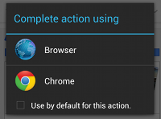
App Chooser
When the Android runtime finds multiple registered activities that can handle an implicit intent, it displays an App Chooser to allow the user to select the handler

Slide 89
Sending Implicit Intents

Slide 90
Sending an implicit intent
Create an intent for an action
Intent intent = new Intent(Intent.ACTION_CALL_BUTTON);
User has pressed Call button. Start an activity that allows them to make a call. No data is passed in or returned.
Start the activity
if (intent.resolveActivity(getPackageManager()) != null) {
startActivity(intent);
}

Slide 91
Avoid exceptions and crashes
Before starting an implicit activity, use the package manager to check that there is a package with an activity that matches the given criteria.
Intent myIntent = new Intent(Intent.ACTION_CALL_BUTTON);
if (intent.resolveActivity(getPackageManager()) != null) {
startActivity(intent);
}

Slide 92
Sending an implicit intent with data URI
Create an intent for action
Intent intent = new Intent(Intent.ACTION_DIAL);
Provide data as a URI
intent.setData(Uri.parse("tel:8005551234"));
Start the activity
if (intent.resolveActivity(getPackageManager()) != null) {
startActivity(intent);
}

Slide 93
Providing the data as URI
Create an URI from a string using Uri.parse(String uri)
Uri.parse("tel:8005551234")
Uri.parse("geo:0,0?q=brooklyn%20bridge%2C%20brooklyn%2C%20ny")
Uri.parse("http://www.android.com");
Uri documentation

Slide 94
Implicit Intents - Examples
Show a web page
Uri uri = Uri.parse("http://www.google.com");
Intent it = new Intent(Intent.ACTION_VIEW,uri);
startActivity(it);
Dial a phone number
Uri uri = Uri.parse("tel:8005551234");
Intent it = new Intent(Intent.ACTION_DIAL, uri);
startActivity(it);

Slide 95
Sending an implicit intent with extras
Create an intent for an action
Intent intent = new Intent(Intent.ACTION_WEB_SEARCH);
Put extras
String query = edittext.getText().toString();
intent.putExtra(SearchManager.QUERY, query));
Start the activity
if (intent.resolveActivity(getPackageManager()) != null) {
startActivity(intent);
}

Slide 96
Category
Additional information about the kind of component to handle the intent.
CATEGORY_OPENABLE
Only allow URIs of files that are openable
CATEGORY_BROWSABLE
Only activities that can start a web browser to display data referenced by the URI

Slide 97
Sending an implicit intent with type and category
Create an intent for an action
Intent intent = new Intent(Intent.ACTION_CREATE_DOCUMENT);
Set mime type and category for additional information
intent.setType("application/pdf"); // set MIME type
intent.addCategory(Intent.CATEGORY_OPENABLE);
continued on next slide...

Slide 98
Sending an implicit intent with type and category
3. Start the activity
if (intent.resolveActivity(getPackageManager()) != null) {
startActivityForResult(myIntent,ACTIVITY_REQUEST_CREATE_FILE);
}
4. Process returned content URI in onActivityResult()

Slide 99
Common actions for implicit intents
Common actions for implicit intents include:
ACTION_SET_ALARM
ACTION_IMAGE_CAPTURE
ACTION_CREATE_DOCUMENT
ACTION_SENDTO
and many more

Slide 100
Apps that handle common actions
Common actions are usually handled by installed apps, both system apps and other apps, such as:
Alarm Clock, Calendar, Camera, Contacts
Email, File Storage, Maps, Music/Video
Notes, Phone, Search, Settings
Text Messaging and Web Browsing
List of common actions for implicit intents
List of all available actions

Slide 101
Receiving Implicit Intents

Slide 102
Register your app to receive intents
Declare one or more intent filters for the activity in the Android manifest
Filter announces activity's ability to accept implicit intents
Filter puts conditions on the intents that the activity accepts

Slide 103
Intent filter in the Android Manifest
<activity android:name="ShareActivity">
<intent-filter>
<action android:name="android.intent.action.SEND"/>
<category android:name="android.intent.category.DEFAULT"/>
<data android:mimeType="text/plain"/>
</intent-filter>
</activity>

Slide 104
Intent filters: action and category
action — Match one or more action constants
  android.intent.action.VIEW — matches all intents with ACTION_VIEW
  android.intent.action.SEND — matches all intents with ACTION_SEND
category — additional information (list of categories)
  android.intent.category.BROWSABLE—can be started by web browser
  android.intent.category.LAUNCHER—Show activity as launcher icon

Slide 105
Intent filters: data
data — Filter on data URIs, MIME type
  android:scheme="https"—require URIs to be https protocol
  android:host="developer.android.com"—only accept intents from specified hosts
  android:mimeType="text/plain"—limit the acceptable types of documents

Slide 106
An activity can have multiple filters
<activity android:name="ShareActivity">
<intent-filter>
<action android:name="android.intent.action.SEND"/>
...
</intent-filter>
<intent-filter>
<action android:name="android.intent.action.SEND_MULTIPLE"/>
...
</intent-filter>
</activity>
An Activity can have several filters

Slide 107
A filter can have multiple actions & data
<intent-filter>
<action android:name="android.intent.action.SEND"/>
<action android:name="android.intent.action.SEND_MULTIPLE"/>
<category android:name="android.intent.category.DEFAULT"/>
<data android:mimeType="image/*"/>
<data android:mimeType="video/*"/>
</intent-filter>

Slide 108
Fragments
Fragment → A portion of the user interface in an Activity.
Introduced from Android 3.0 (API Level 11)
Practically, a Fragment is a modular section of an Activity.
DESIGN PHILOSOPHY
Structure an Activity as a collection of Fragments.
Reuse a Fragment on different Activities …

Slide 109
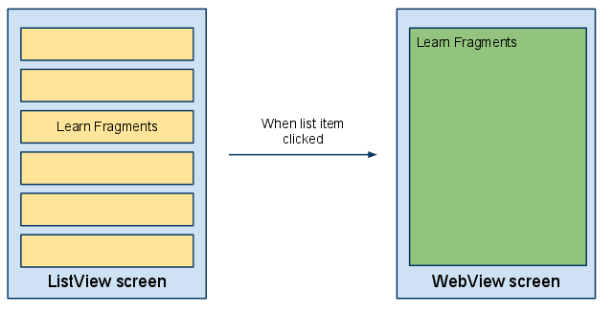
EXAMPLE: Structuring an Application using multiple Activities.

Slide 110
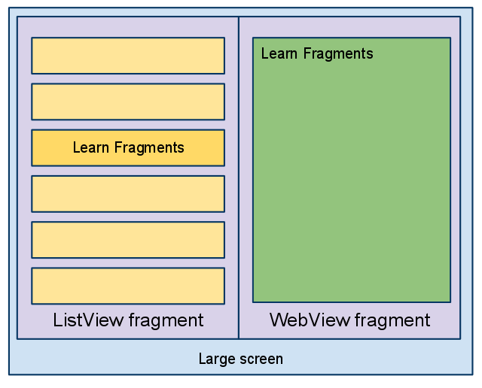
EXAMPLE: Structuring an Application using 1 Activity and 2 Fragments.

Slide 111
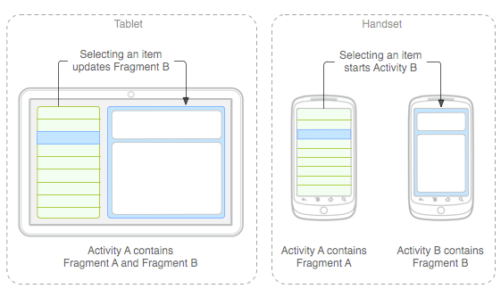
EXAMPLE: Using Fragments on Different Devices (Smartphone/Tab)

Slide 112
To define a new Fragment → create a subclass of Fragment.
PROPERTY of a Fragment:
Has its own lifecycle (partially connected with the Activity lifecyle)
Has its own layout (or may have)
Can receive its own input events
Can be added or removed while the Activity is running.

Slide 113
Specify layout properties for the Fragment as it were a View.
<?xml version="1.0" encoding="utf-8"?>
<LinearLayout xmlns:android="http://schemas.android.com/apk/res/android"
android:layout_width="fill_parent"
android:layout_height="fill_parent"
android:orientation="horizontal" >
<fragment android:name="it.cs.android30.FragmentOne"
android:id="@+id/f1"
android:layout_width="wrap_content"
android:layout_height="fill_parent"
/>
<fragment android:name="it.cs.android30.FragmentTwo"
android:id="@+id/f2"
android:layout_width="wrap_content"
android:layout_height="fill_parent"
/>
</LinearLayout>

Slide 114
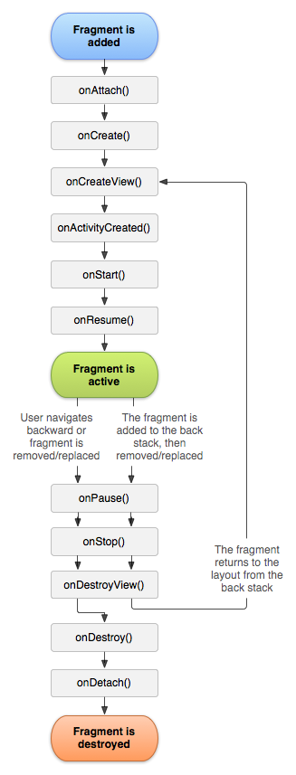
Android: Fragment Lifecycle
Several callback methods to handle various stages of a Fragment lifecycle:
onCreate() → called when creating the Fragment.
onCreateView() → called when it is time for the Fragment to draw the user interface the first time.
onPause() → called when the user is leaving the Fragment.

Slide 115
Android: Fragment Creation
onCreateView() → must return the View associated to the UI of the Fragment (if any) …
public class ExampleFragment extends Fragment {
@Override
public View onCreateView(LayoutInflater inflater, ViewGroup container, Bundle saved) {
return inflater.inflate(R.layout.example_fragment, container, false);
}

Slide 116
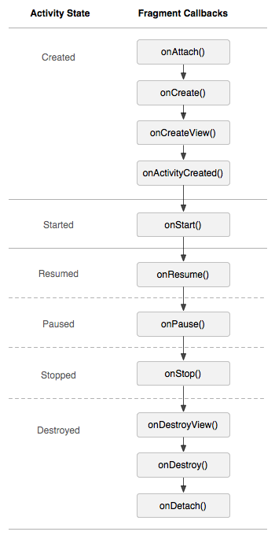
Android: Fragment Lifecycle
The lifecycle of the Activity in which the Fragment lives directly affects the lifecycle of the Fragment.
onPause (Activity) → onPause (Fragment)
onStart (Activity) → onStart (Fragment)
onDestroy (Activity) → onDestroy (Fragment)
Fragments have also extra lifecycle callbacks to enable runtime creation/destroy.

Slide 117
A Fragment can get a reference to the Activity …
Activity getActivity()
An Activity can get a reference to the Fragment …
ExampleFragment fragment=(ExampleFragment) getFragmentManager().findFragmentById(R.id.example_fragment)
The FragmentManager manages the Fragment associated to the current Activity.

Slide 118
Android: Managing Fragments
In some cases, a Fragment must share an event with the Activity … how to do it?
Define a callback interface inside the Fragment
2.Require that the host Activity implements it
public interface OnArticleSelectedListener {
public void onArticleSelected(Uri uri);
…
}

Slide 119
Fragments can be added/removed/replaced while the Activity is running …
Each set of changes to the Activity is called a Transaction.
Transaction can be saved in order to allow a user to navigate backward among Fragments when he clicks on the “Back” button.

Slide 120
Android: Fragment Transactions
1. ACQUIRE an instance of the FRAGMENT MANAGER
FragmentManager man=getFragmentManager();
FragmentTransaction transaction=man.beginTransaction();
2. CREATE new Fragment and Transaction
FragmentExample newFragment=new FragmentExample();
transaction.replace(R.id.fragment_container, newFragment);
3. SAVE to backStack and COMMIT
transaction.addToBackState(null);
transaction.commit();

Slide 121
A Transaction is not performed till the commit …
If addToBackStack() is not invoked → the Fragment is destroyed and it is not possible to navigate back.
If addToBackStack() is invoked → the Fragment is stopped and it is possible to resume it when the user navigates back.
popBackStack() → simulate a Back from the user.

